Slide 1
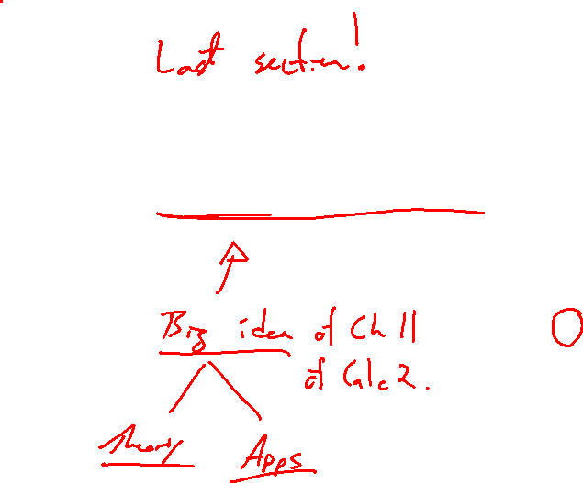
Section 11.10 Taylor Series and Maclaurin Series
Lecture 1
Taylor Series

Slide 2

Section Homework Submission to Canvas
Preview of section​
Skim section, write short paragraph summary, list all important definitions / theorems / formulas.​
Notes on video lectures​
Include all details, worked examples, your own thoughts​
Worked examples from text​
Solutions to exercises​
Final reflection of section​
List of key takeaways to remember​

Slide 3
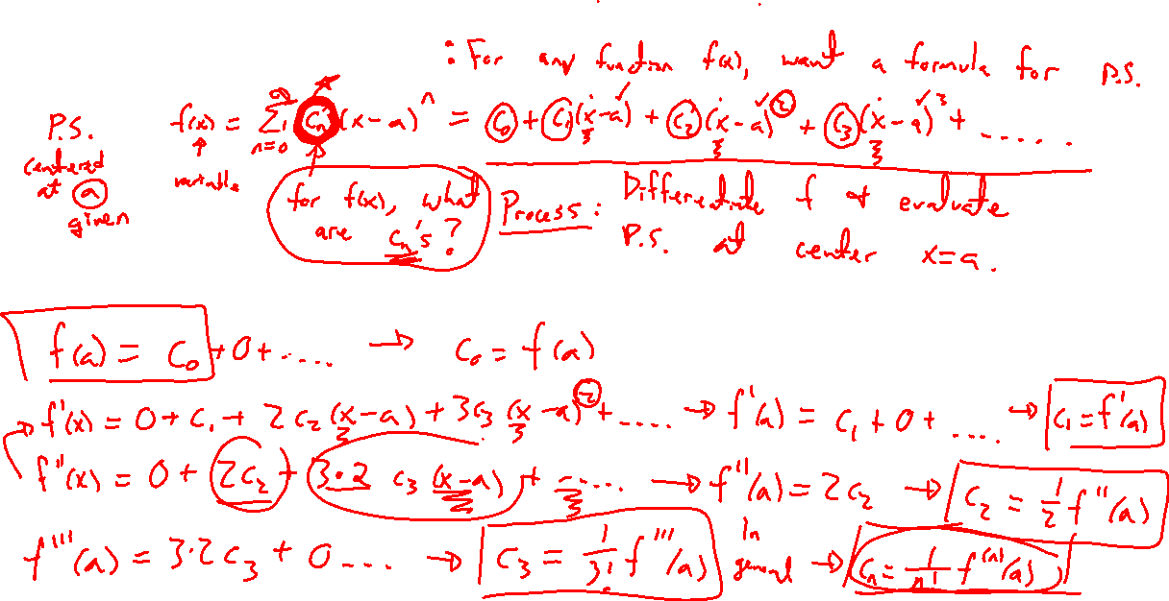
Taylor Series Idea
Notes:
F(x) = power series centered at x=a
Can differentiate both sides according to last section, and radius of convergence doesn’t change
Plug in x=a
Diff, plug in x=a, etc
Equat sides to get formula for c_n
Factorial reminder: n!, 0!=1

Slide 4
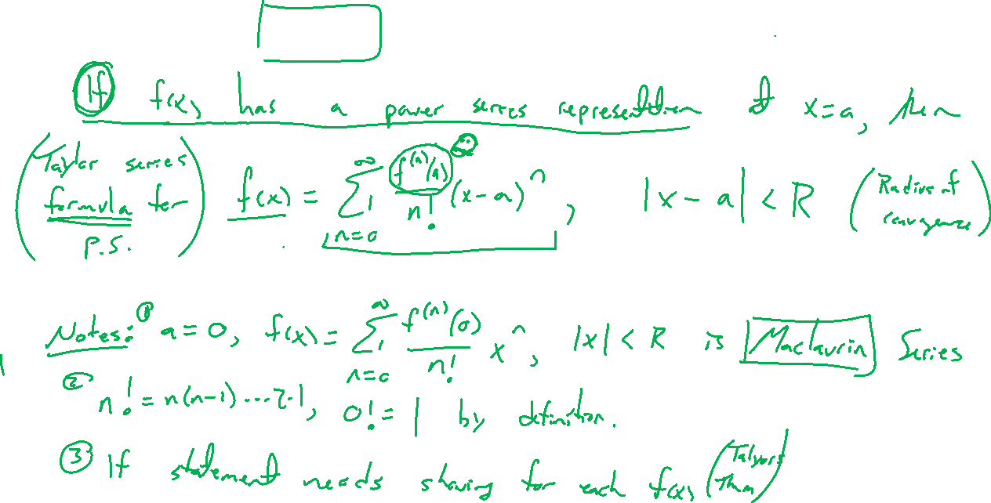
Theorem: Taylor Series
Notes:
If f(x) has a power representation centered at x=a, then it is....formula
Notes: a=0 called Maclaurin series
Simplish formula, not really easy to use (need f^(n)(a)) formula

Slide 5
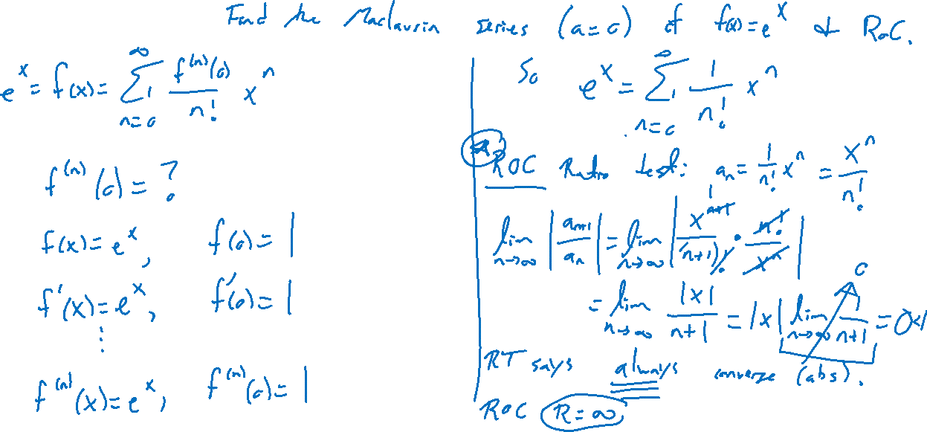
Example:
Notes:
Find Taylor series and RoC
F(x) = e^x

Slide 6
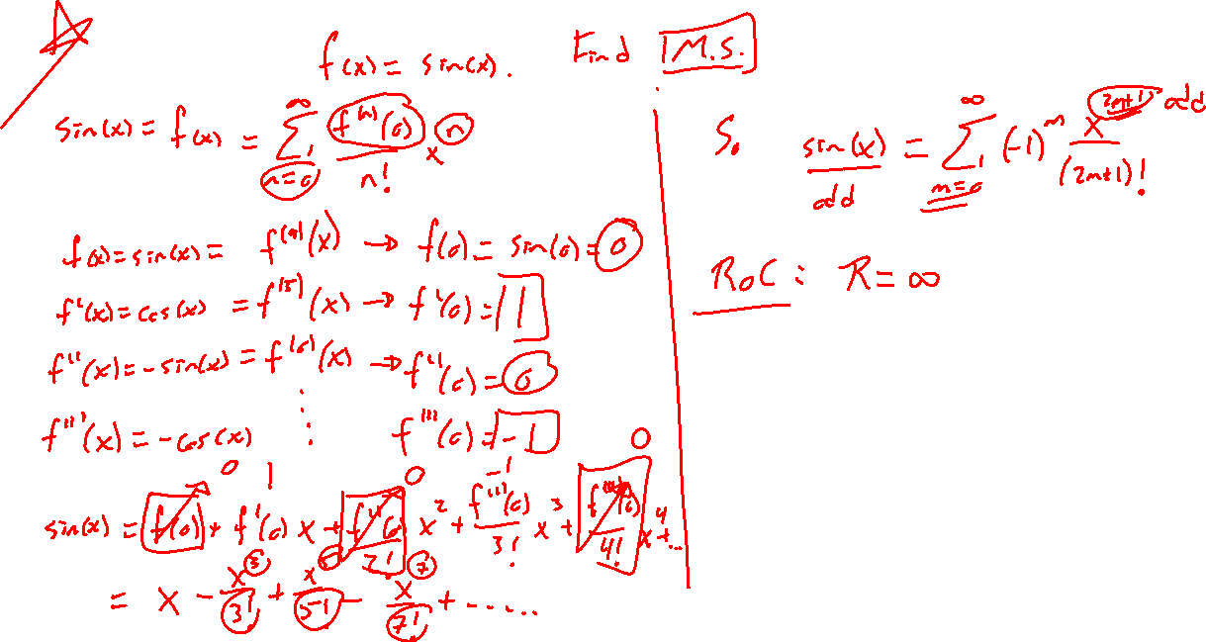
Example:
Notes:
Find Taylor series and RoC
F(x) = sin(x)

Slide 7
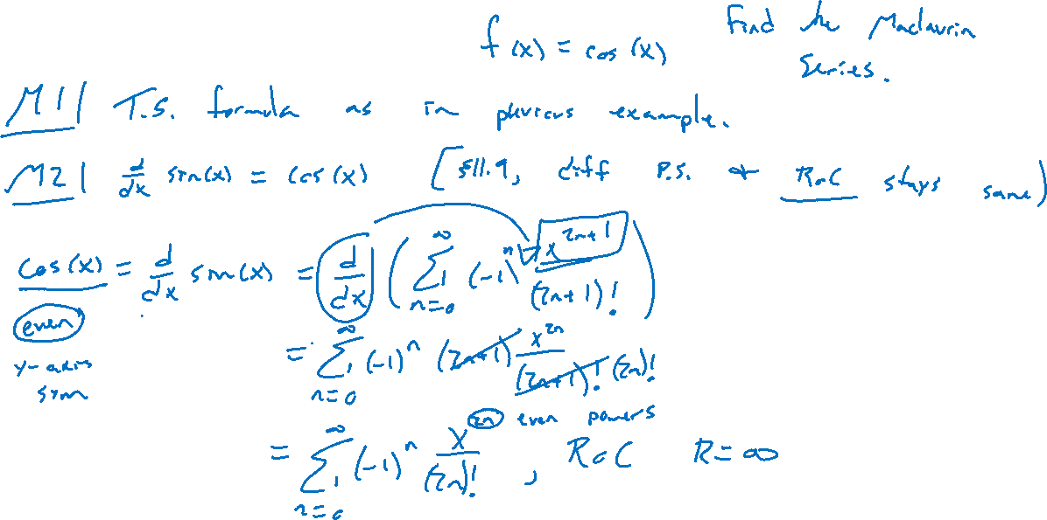
Example: Try on Own
Notes:
Find Taylor series and RoC
F(x) = cos(x)

Slide 8
Power Series Formulas
Notes:
E^x, sin(x), cos(x), 1/(1-x), ln(1-x)
Mention can try Taylor's formula for last two to see agree
Desmos demo for first 3

Slide 9
Example: Center Not Zero
Notes:
Sin(x), a=pi/2

